Slide 1

Healthcare Data Analysis Predicting Billing Amount for the Ages
Presented by: J’yanni Ellis and Sunita Thakur

Slide 2
contents
Importance of data analysis in healthcare
Kaggle’s healthcare dataset analysis
Observations
Predicting billing amount for the ages by using regression analysis
Time series forecasting
Conclusion

Slide 3
Importance of Data Analysis in Healthcare
Enhances decision-making
Improves patient care
Supports resource management
Facilitates research and innovation
Cost reduction
Minimizing medical errors
Financial risk control
Disease prediction and prevention

Slide 4
Data
This dataset collected from Kaggle.com contains information about patients admitted to a hospital, including demographic details, medical conditions, treatments, and billing information. The dataset comprises the following columns:
Name, Age, Gender, Blood Type, Medical Condition, Date of Admission, Doctor, Hospital, Insurance Provider, Billing Amount, Room Number, Admission Type, Discharge Date, Medication, Test Results

Slide 5
Observations
Patients ages range from 13 to 89 years with the average of 52.
Data spans from May 8, 2019, to May 7, 2024, providing a comprehensive five-year view of patient admissions.
Admission types: Emergency, Elective, Transfer
Blood types: A+, A-, B+, B-, O+, O-, AB+, AB-
A- blood group is the most prevalent.
The dataset encompasses admissions from 44 hospitals, with LLC Smith being the most frequent.
Total Doctors in the dataset are 27 and Michael Smith attends to the highest number of patients.
Male patients are more than the female patients.
Arthritis is the topmost disease in the hospitals
Diabetes treatment costs are the highest.

Slide 6
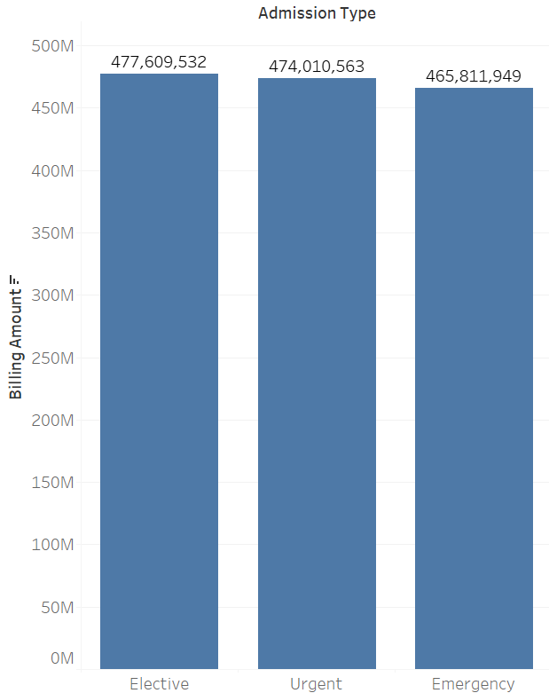
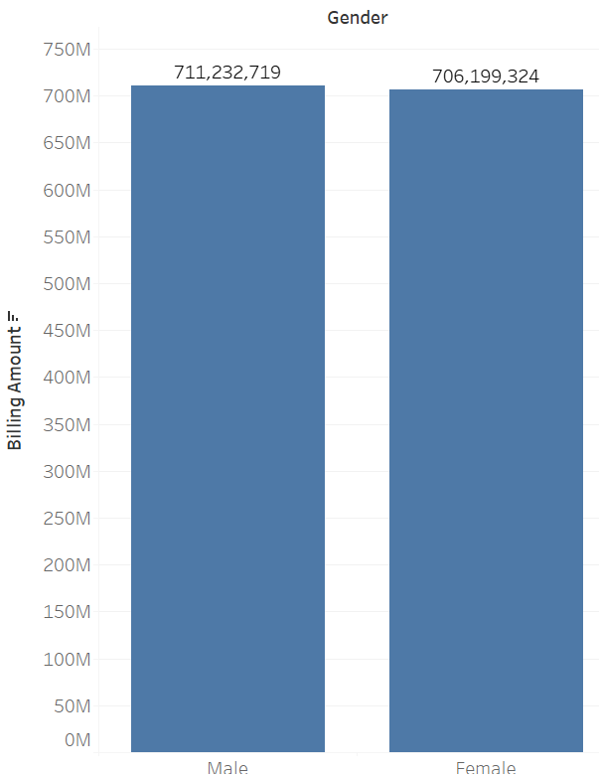
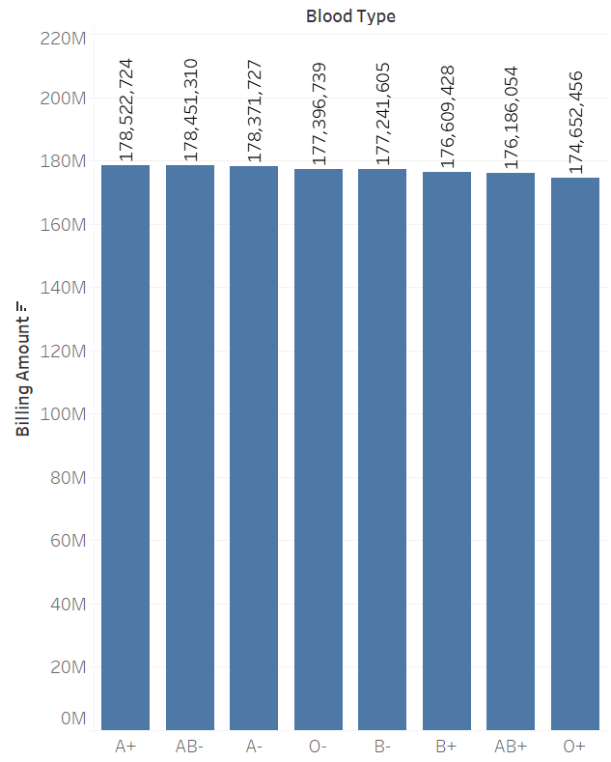
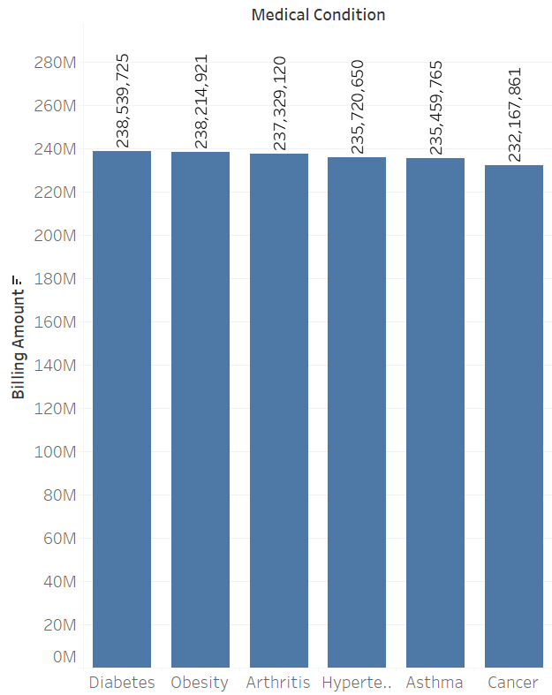
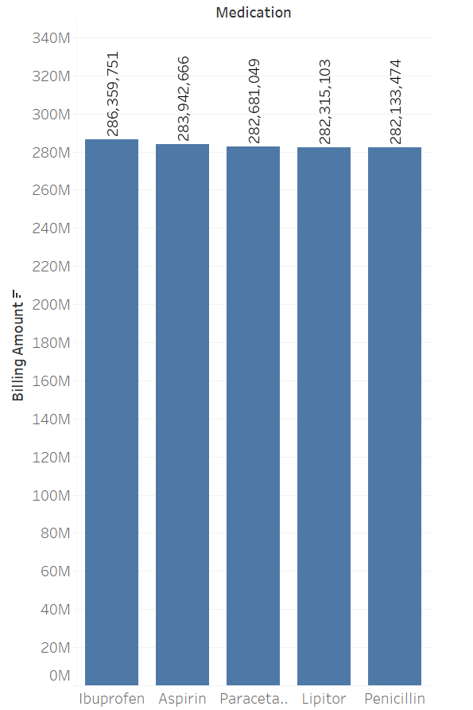
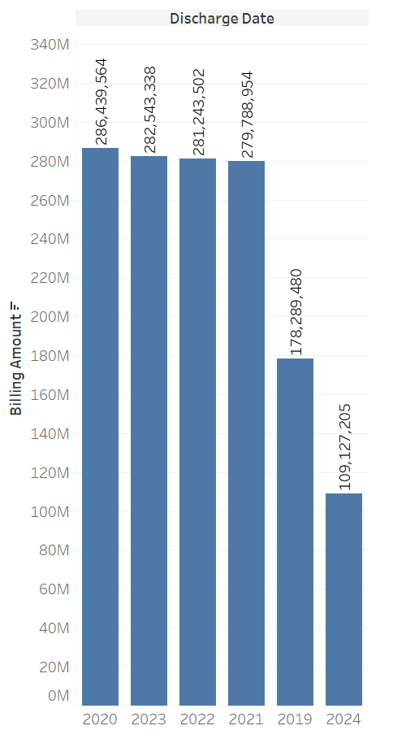
Billing amount for admission types, gender, blood type, medical condition, medication, and discharge date in descending order

Slide 7
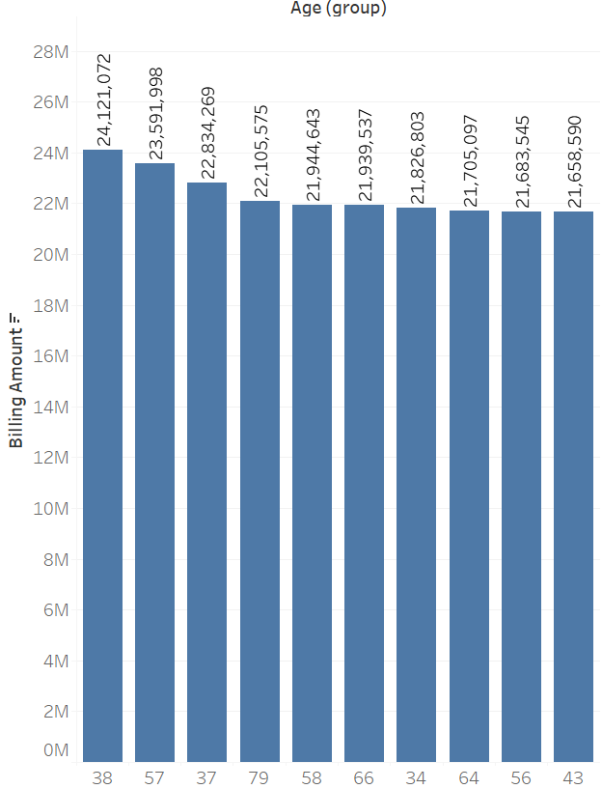
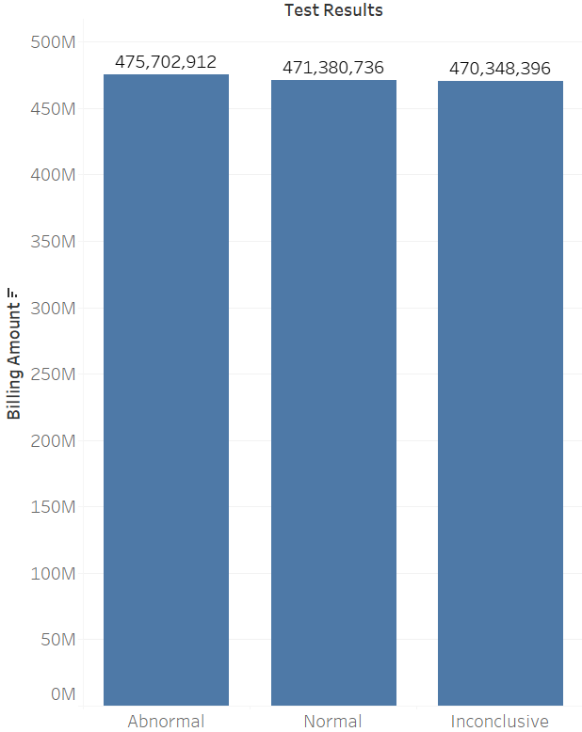
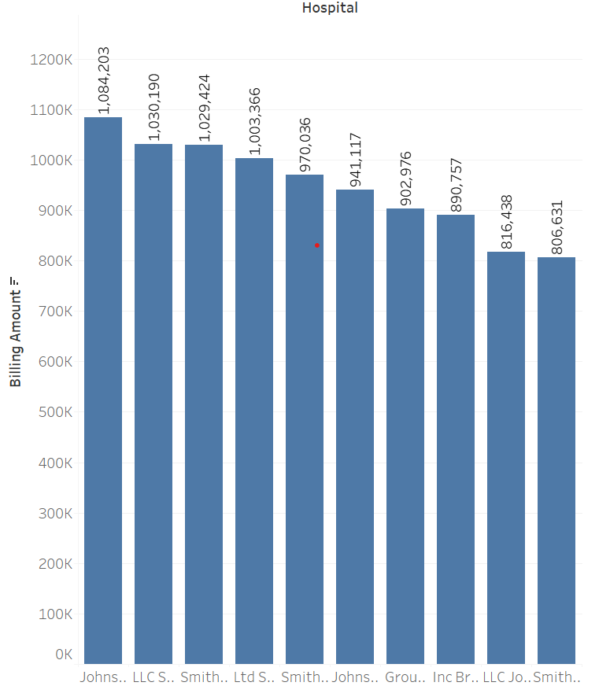
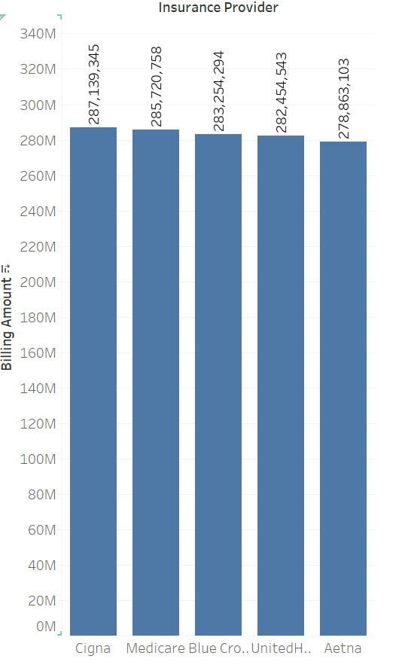
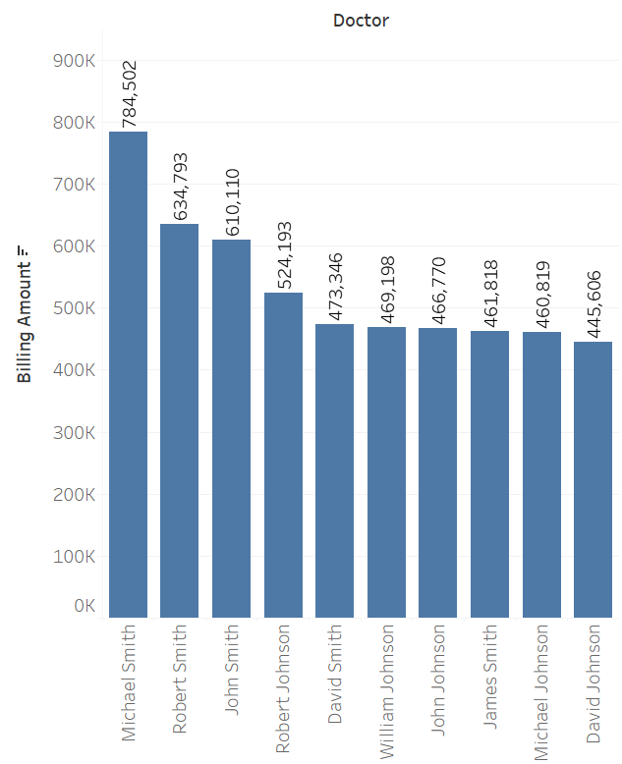
Billing amount for age(groups), test results, hospital, insurance provider, and doctor in descending order

Slide 8
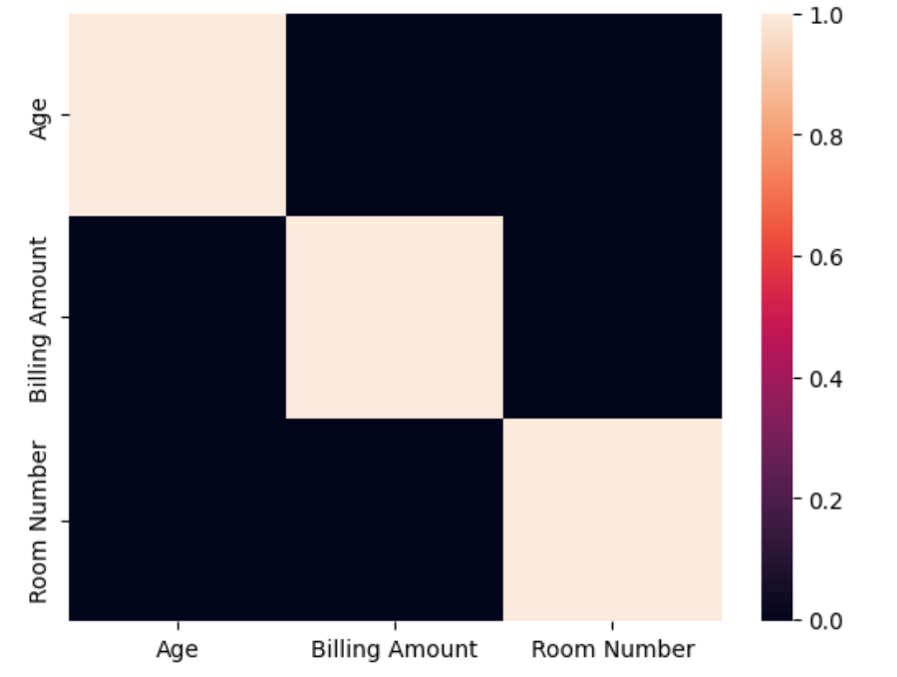
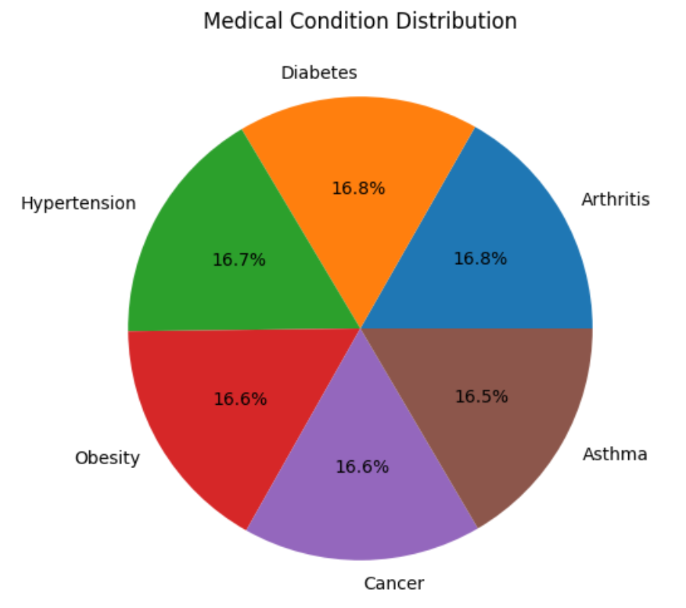
Correlation between billing amount and age medical conditions
There is no significance correlation between billing amount and age.
Arthritis is the topmost disease in the hospitals.

Slide 9
Methodology
Dependent variable: Billing amount
Independent variable: Age
Linear regression
Lasso Regression
Classification
Time series forecasting: ARIMA, SARIMA, and AUTO ARIMA models

Slide 10
Billing amount predictions for the ages by linear regression and lasso regression
Linear Regression Predictions
Lasso Regression Predictions
Age | Billing amount
38 | 25559.39
51 | 25532.55
78 | 25476.82
19 | 25598.61
50 | 25534.62
61 | 25511.91
71 | 25491.27
58 | 25518.1
49 | 25536.68
74 | 25485.08
50 | 25534.62
34 | 25567.64
61 | 25511.91
50 | 25534.62
38 | 25559.39
72 | 25489.21
24 | 25588.29
21 | 25594.48
40 | 25555.26
39 | 25557.32
32 | 25571.77
42 | 25551.13
39 | 25557.32
80 | 25472.69
39 | 25557.32
81 | 25470.63
56 | 25522.23
20 | 25596.54
43 | 25549.07
66 | 25501.59
20 | 25596.54
29 | 25577.96
75 | 25483.01
60 | 25513.98
76 | 25480.95
48 | 25538.75
67 | 25499.53
85 | 25462.37
26 | 25584.16
71 | 25491.27
27 | 25582.09
58 | 25518.1
64 | 25505.72
73 | 25487.14
24 | 25588.29
58 | 25518.1
50 | 25534.62
41 | 25553.19
71 | 25491.27
26 | 25584.16
24 | 25588.29
23 | 25590.35
78 | 25476.82
30 | 25575.9
55 | 25524.3
65 | 25503.66
40 | 25555.26
42 | 25551.13
77 | 25478.89
24 | 25588.29
37 | 25561.45
67 | 25499.53
64 | 25505.72
52 | 25530.49
82 | 25468.56
41 | 25553.19
30 | 25575.9
44 | 25547
73 | 25487.14
22 | 25592.41
78 | 25476.82
46 | 25542.87
57 | 25520.17
73 | 25487.14
72 | 25489.21
46 | 25542.87
84 | 25464.44
22 | 25592.41
19 | 25598.61
26 | 25584.16
63 | 25507.78
19 | 25598.61
59 | 25516.04
56 | 25522.23
38 | 25559.39
40 | 25555.26
58 | 25518.1
61 | 25511.91
79 | 25474.76
18 | 25600.67
26 | 25584.16
25 | 25586.22
36 | 25563.52
72 | 25489.21
48 | 25538.75
36 | 25563.52
60 | 25513.98
31 | 25573.84
62 | 25509.85
55 | 25524.3
82 | 25468.56
42 | 25551.13
87 | 25458.24
60 | 25513.98
34 | 25567.64
23 | 25590.35
38 | 25559.39
39 | 25557.32
65 | 25503.66
43 | 25549.07
71 | 25491.27
Age | Billing amount
38 | 25559.39
51 | 25532.55
78 | 25476.82
19 | 25598.61
50 | 25534.62
61 | 25511.91
71 | 25491.27
58 | 25518.1
49 | 25536.68
74 | 25485.08
50 | 25534.62
34 | 25567.64
61 | 25511.91
50 | 25534.62
38 | 25559.39
72 | 25489.21
24 | 25588.28
21 | 25594.48
40 | 25555.26
39 | 25557.32
32 | 25571.77
42 | 25551.13
39 | 25557.32
80 | 25472.69
39 | 25557.32
81 | 25470.63
56 | 25522.23
20 | 25596.54
43 | 25549.07
66 | 25501.59
20 | 25596.54
29 | 25577.96
75 | 25483.01
60 | 25513.98
76 | 25480.95
48 | 25538.75
67 | 25499.53
85 | 25462.37
26 | 25584.16
71 | 25491.27
27 | 25582.09
58 | 25518.1
64 | 25505.72
73 | 25487.14
24 | 25588.28
58 | 25518.1
50 | 25534.62
41 | 25553.19
71 | 25491.27
26 | 25584.16
24 | 25588.28
23 | 25590.35
78 | 25476.82
30 | 25575.9
55 | 25524.3
65 | 25503.66
40 | 25555.26
42 | 25551.13
77 | 25478.89
24 | 25588.28
37 | 25561.45
67 | 25499.53
64 | 25505.72
52 | 25530.49
82 | 25468.57
41 | 25553.19
30 | 25575.9
44 | 25547
73 | 25487.14
22 | 25592.41
78 | 25476.82
46 | 25542.87
57 | 25520.17
73 | 25487.14
72 | 25489.21
46 | 25542.87
84 | 25464.44
22 | 25592.41
19 | 25598.61
26 | 25584.16
63 | 25507.78
19 | 25598.61
59 | 25516.04
56 | 25522.23
38 | 25559.39
40 | 25555.26
58 | 25518.1
61 | 25511.91
79 | 25474.76
18 | 25600.67
26 | 25584.16
25 | 25586.22
36 | 25563.52
72 | 25489.21
48 | 25538.75
36 | 25563.52
60 | 25513.98
31 | 25573.84
62 | 25509.85
55 | 25524.3
82 | 25468.57
42 | 25551.13
87 | 25458.24
60 | 25513.98
34 | 25567.64
23 | 25590.35
38 | 25559.39
39 | 25557.32
65 | 25503.66
43 | 25549.07
71 | 25491.27

Slide 11
Model evaluation
Linear regression
Mean Absolute Error: 12295.712152020222
Mean Squared Error: 202584280.70492148
Root Mean Squared Error: 14233.210484810568
Lasso regression
Mean Absolute Error: 12295.712152108861
Mean Squared Error: 202584280.7764024
Root Mean Squared Error: 14233.210487321629
Billing amount prediction for the ages by Linear regression is better than Lasso regression because of smaller root mean squared error.
Classification
Logistic Regression classifier with accuracy 0.50599 is better than Decision tree classifier with accuracy 0.50595.

Slide 12
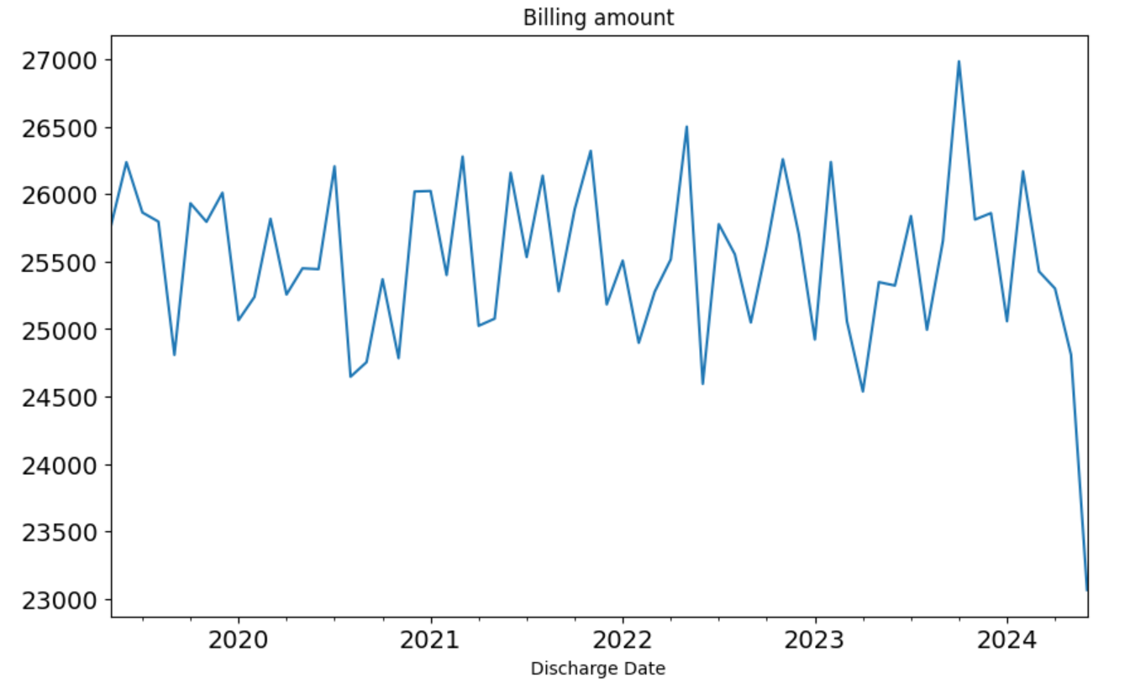
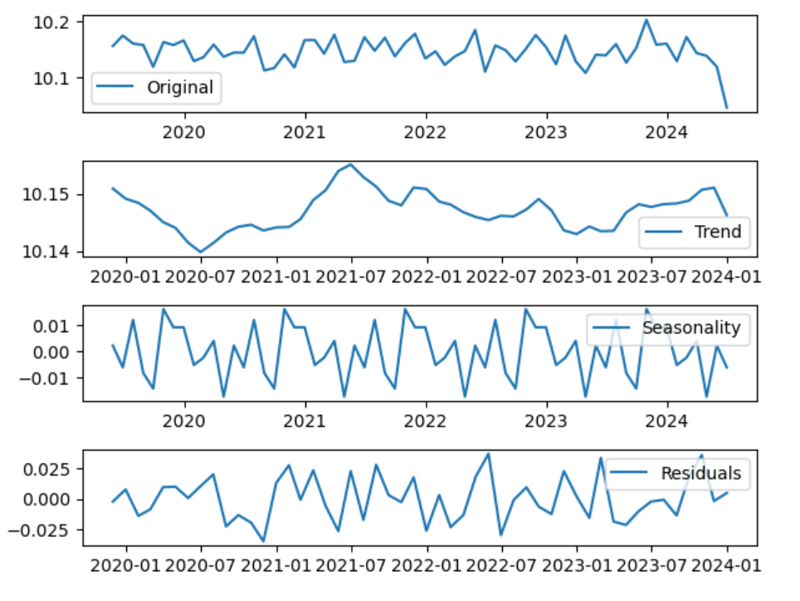
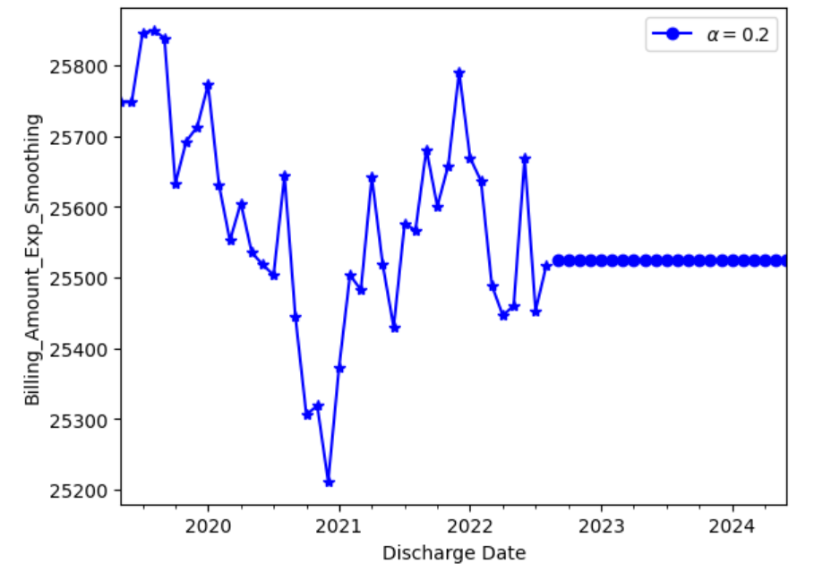
Time series plotting, decomposing, and BILLING AMOUNT FORCASTING

Slide 13
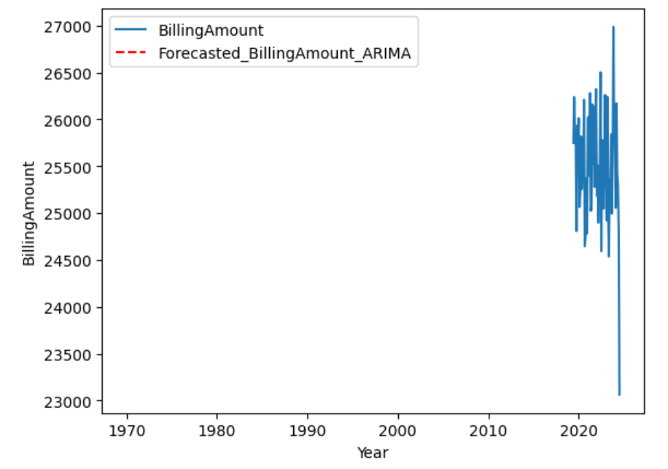
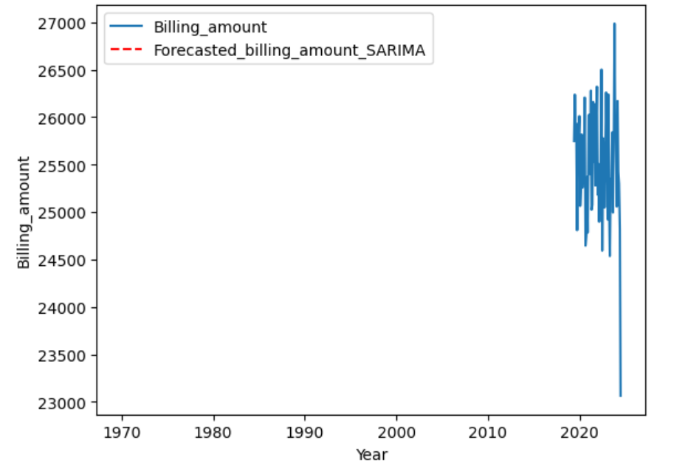
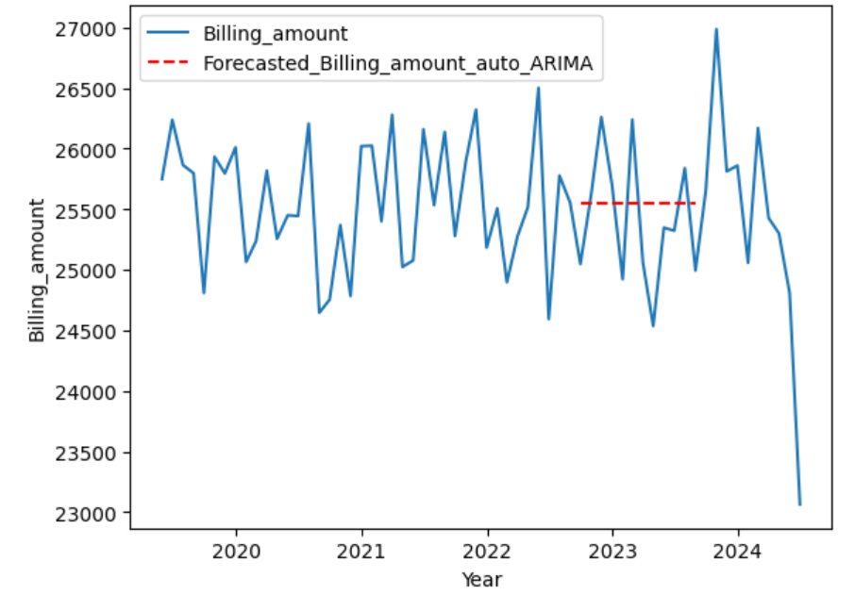
Time series BILLING AMOUNT FORCASTING and model evaluation
ARIMA model’s AIC
= 632.49
SARIMA model’s AIC
= 463.29
Model with smaller AIC is the better model.
SARIMA model is better in forecasting than ARIMA model.

Slide 14
Conclusion
Maximum billing amount is for the ages: 38, admission type: elective, gender: male, blood type: A+, medical condition: diabetes, medication: ibuprofen, discharge date: 2020, test results: abnormal, hospital: John’s, Doctor: Michael Smith, insurance provider: Ciagna.
Arthritis and diabetes are the topmost diseases in the hospitals.
Future trends for the billing amount is constant in the hospitals.
This dataset provides valuable insights into patient demographics, medical conditions, treatment patterns, and hospital operations. It can be used for various analyses, including better patient outcome prediction, more efficient resource management, informed decision-making and healthcare quality improvement initiatives.

Slide 15
REFERENCES
[1] Analysis: https://www.kaggle.com/code/muhammadfurqan0/unlocking-healthcare-trends-data-analysis
[2] Analysis: https://www.kaggle.com/code/youssefayman22/simple-neural-network-algorithm
[3] Dataset: https://www.kaggle.com/datasets/prasad22/healthcare-dataset

Slide 16
Thank you

Slide 17
Questions?

